Slide 1

Introducing dask-geomodeling
Casper van der Wel
casper.vanderwel@nelen-schuurmans.nl
Foss4G BE, October 24th, 2019
Notes:
<number>

Slide 2

Nelen & Schuurmans
Private company
IT products & consultancy
Water management
Web based GIS platform / flood simulation
Notes:
KORT houden
Utrecht city centre
<number>

Slide 3
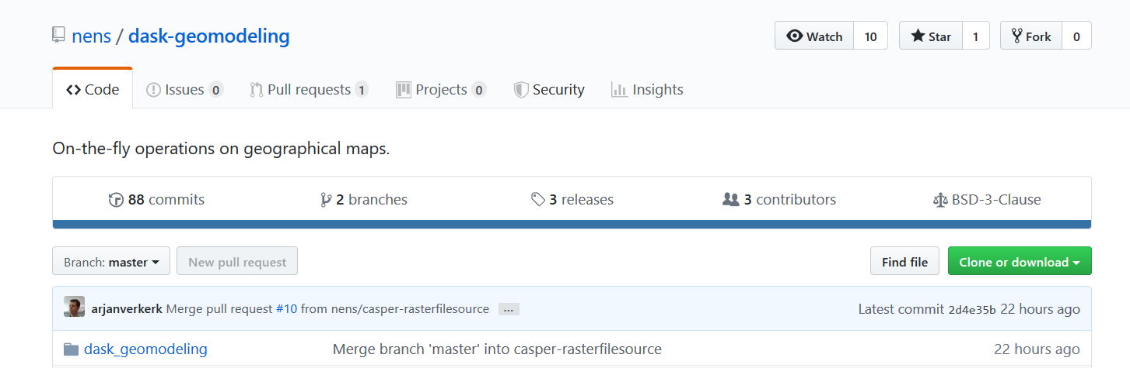
Introducing dask-geomodeling
Python source code: https://github.com/nens/dask-geomodeling

Slide 4
What does dask-geomodeling do?
GIS data is often derived data
Water depth = water level – elevation
Rain deficit = evaporation – rainfall
Heat stress model = f(land color, elevation, wind strength, land use)
dask-geomodeling: framework to perform scalable GIS analytics
fast computation of limited areas
parallelized computation of larger areas
Built with dask, numpy, pandas scipy, geopandas, and gdal
Notes:
<number>

Slide 5
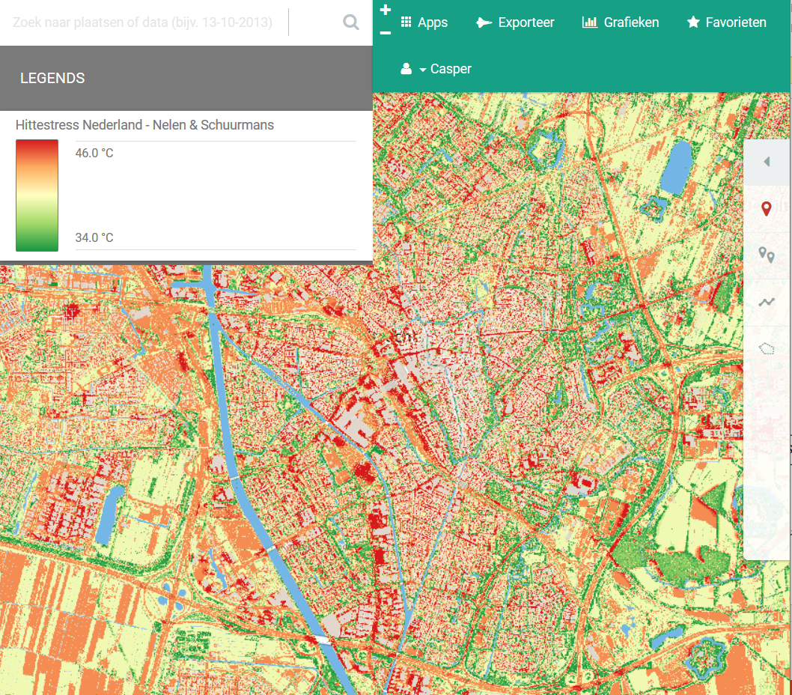
Notes:
https://demo.lizard.net/nl/map/topography,raster$3d404c6
https://demo.lizard.net/api/v4/geoblocks/d0470e71-1c99-4944-b26b-0e7057354098/
<number>

Slide 6
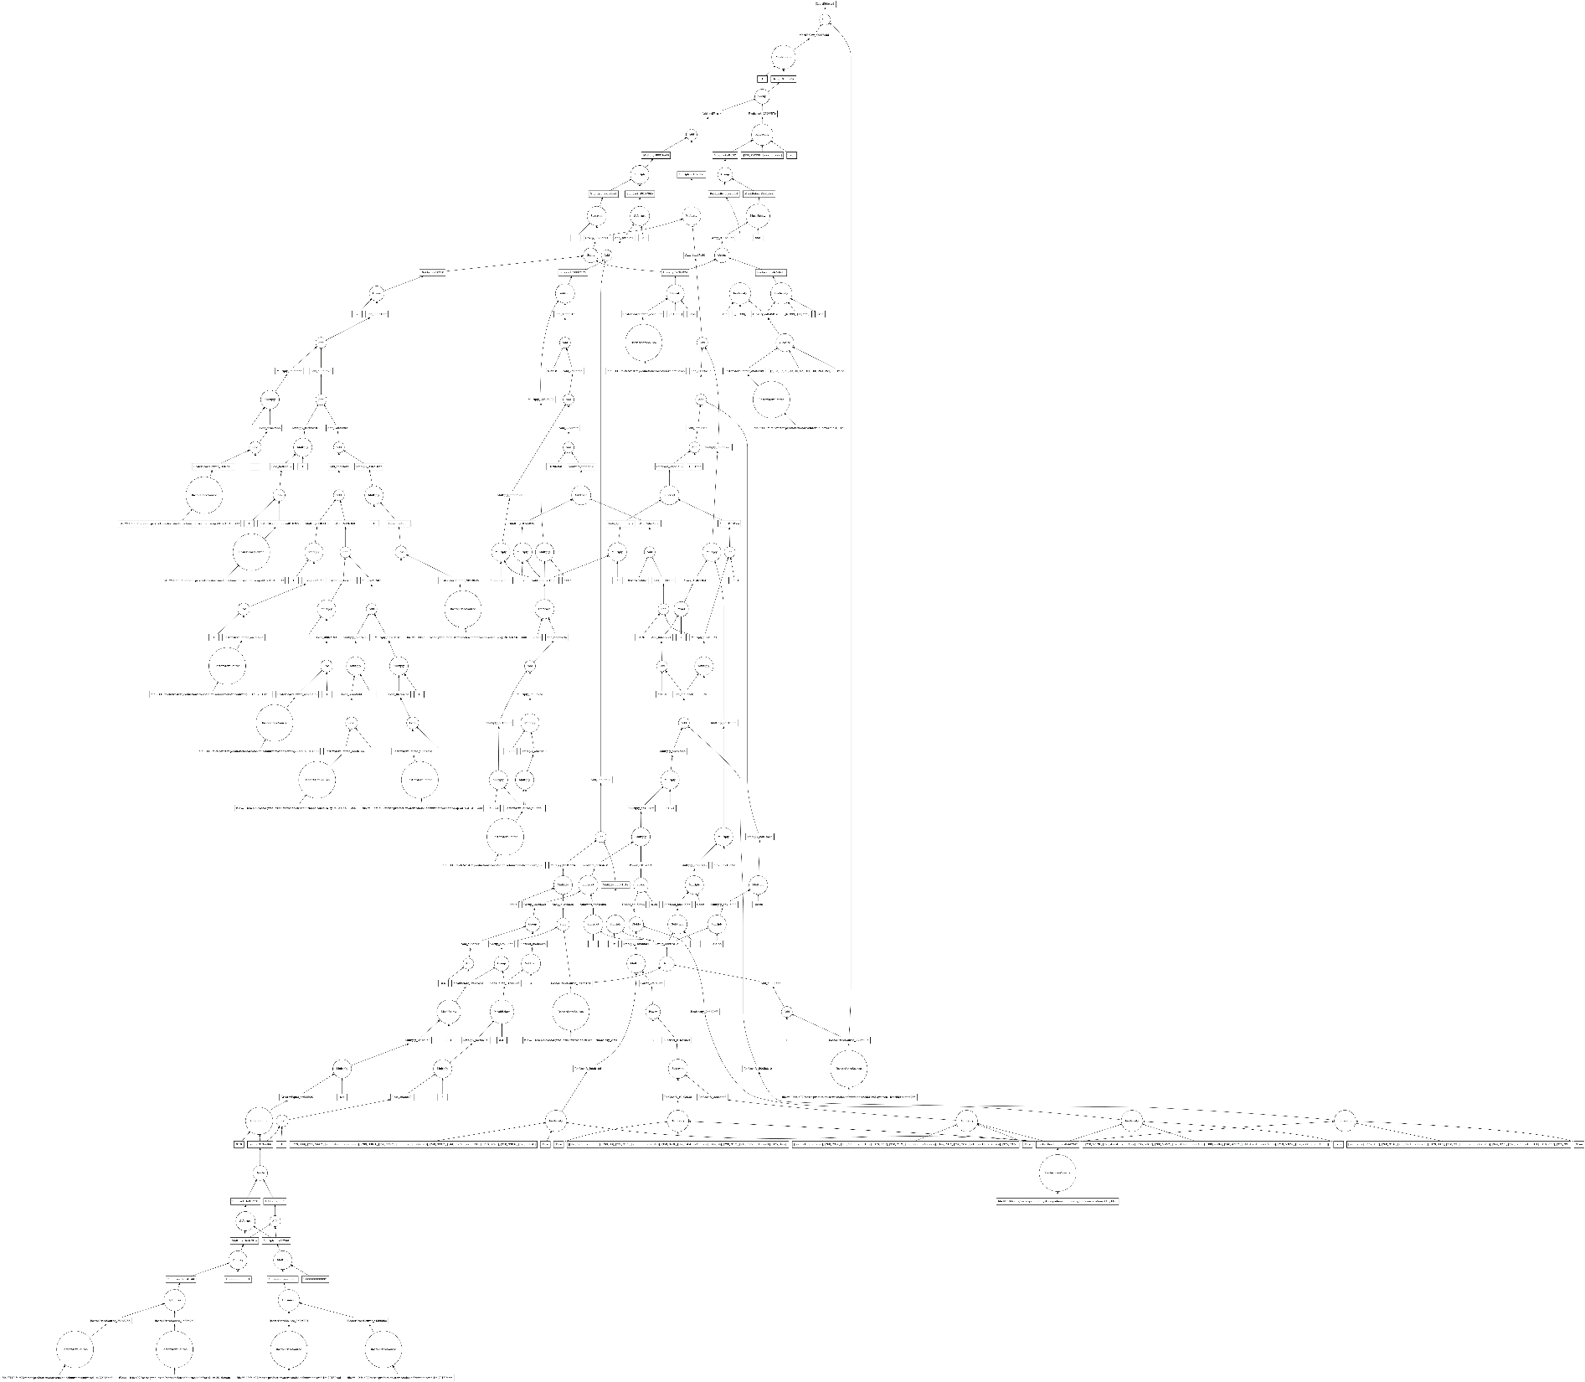
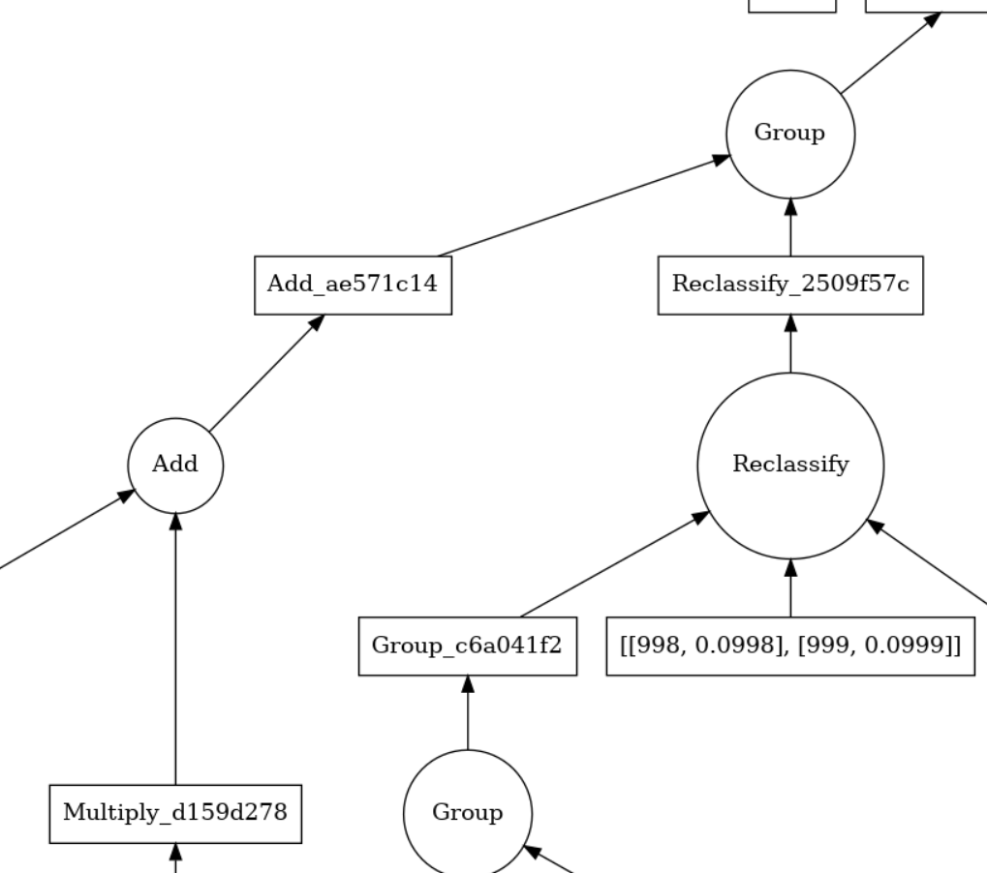
Graph
Notes:
<number>

Slide 7
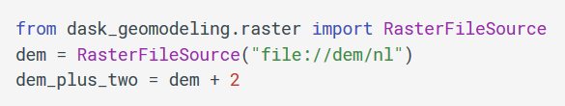
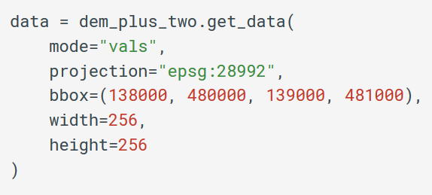
dask-geomodeling: a quickstart
Define the view “dem_plus_two”:
Get a 256x256 array of data from it:
Notes:
<number>

Slide 8
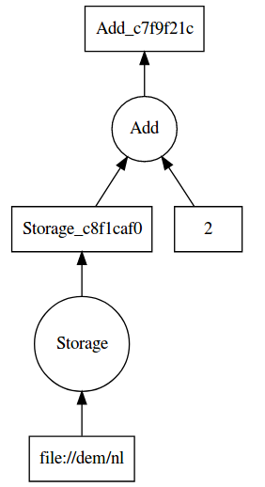

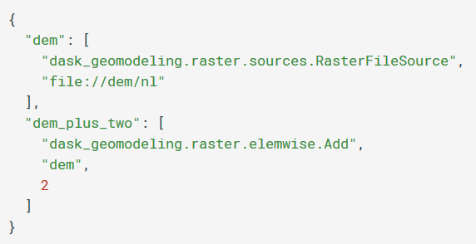
View definition

Slide 9
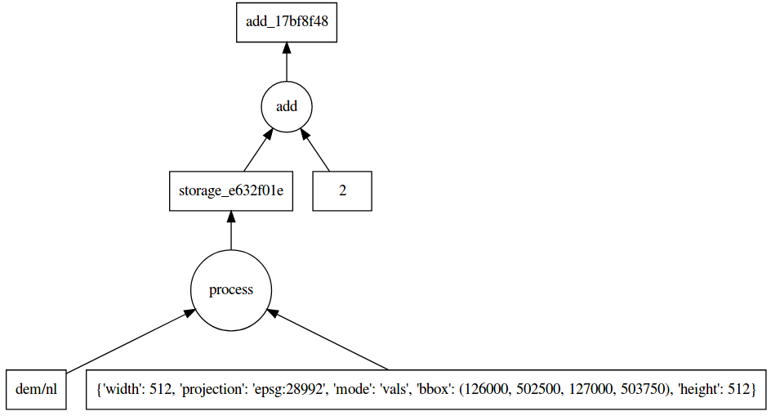
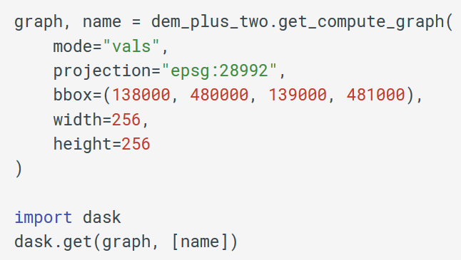
Delayed computation
Submit a compute graph to dask:
{'add_17bf8f484a4f10b4463ed79d6eca516b':
(<function operator.add>,
'storage_e632f01e955cbb8c7cade095e0768ba9',
2),
'storage_e632f01e955cbb8c7cade095e0768ba9':
(<function raster_store.wrappers.process>,
'file://dem/nl',
{'bbox': (126000, 502500, 127000, 503750),
'height': 512,
'mode': 'vals',
'projection': 'epsg:28992',
'width': 512})
}
Notes:
<number>

Slide 10
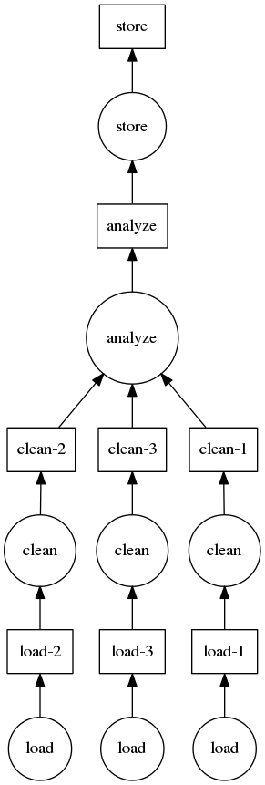
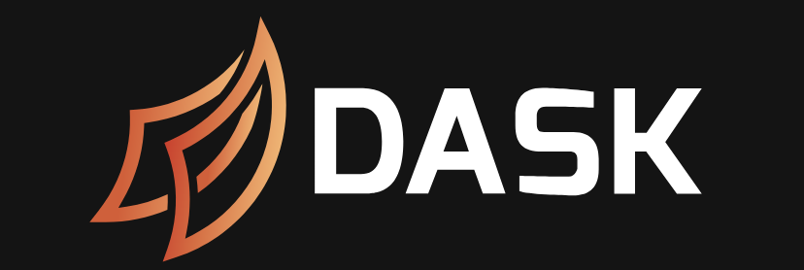
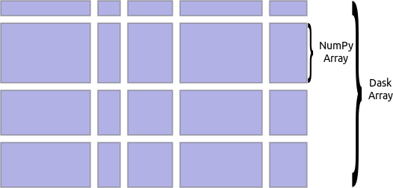
Dask
Big data in Python
A computation can be executed in multiple ways:
single thread
multithreading / multiprocessing
distributed
Notes:
+ NumFocus logo
<number>

Slide 11
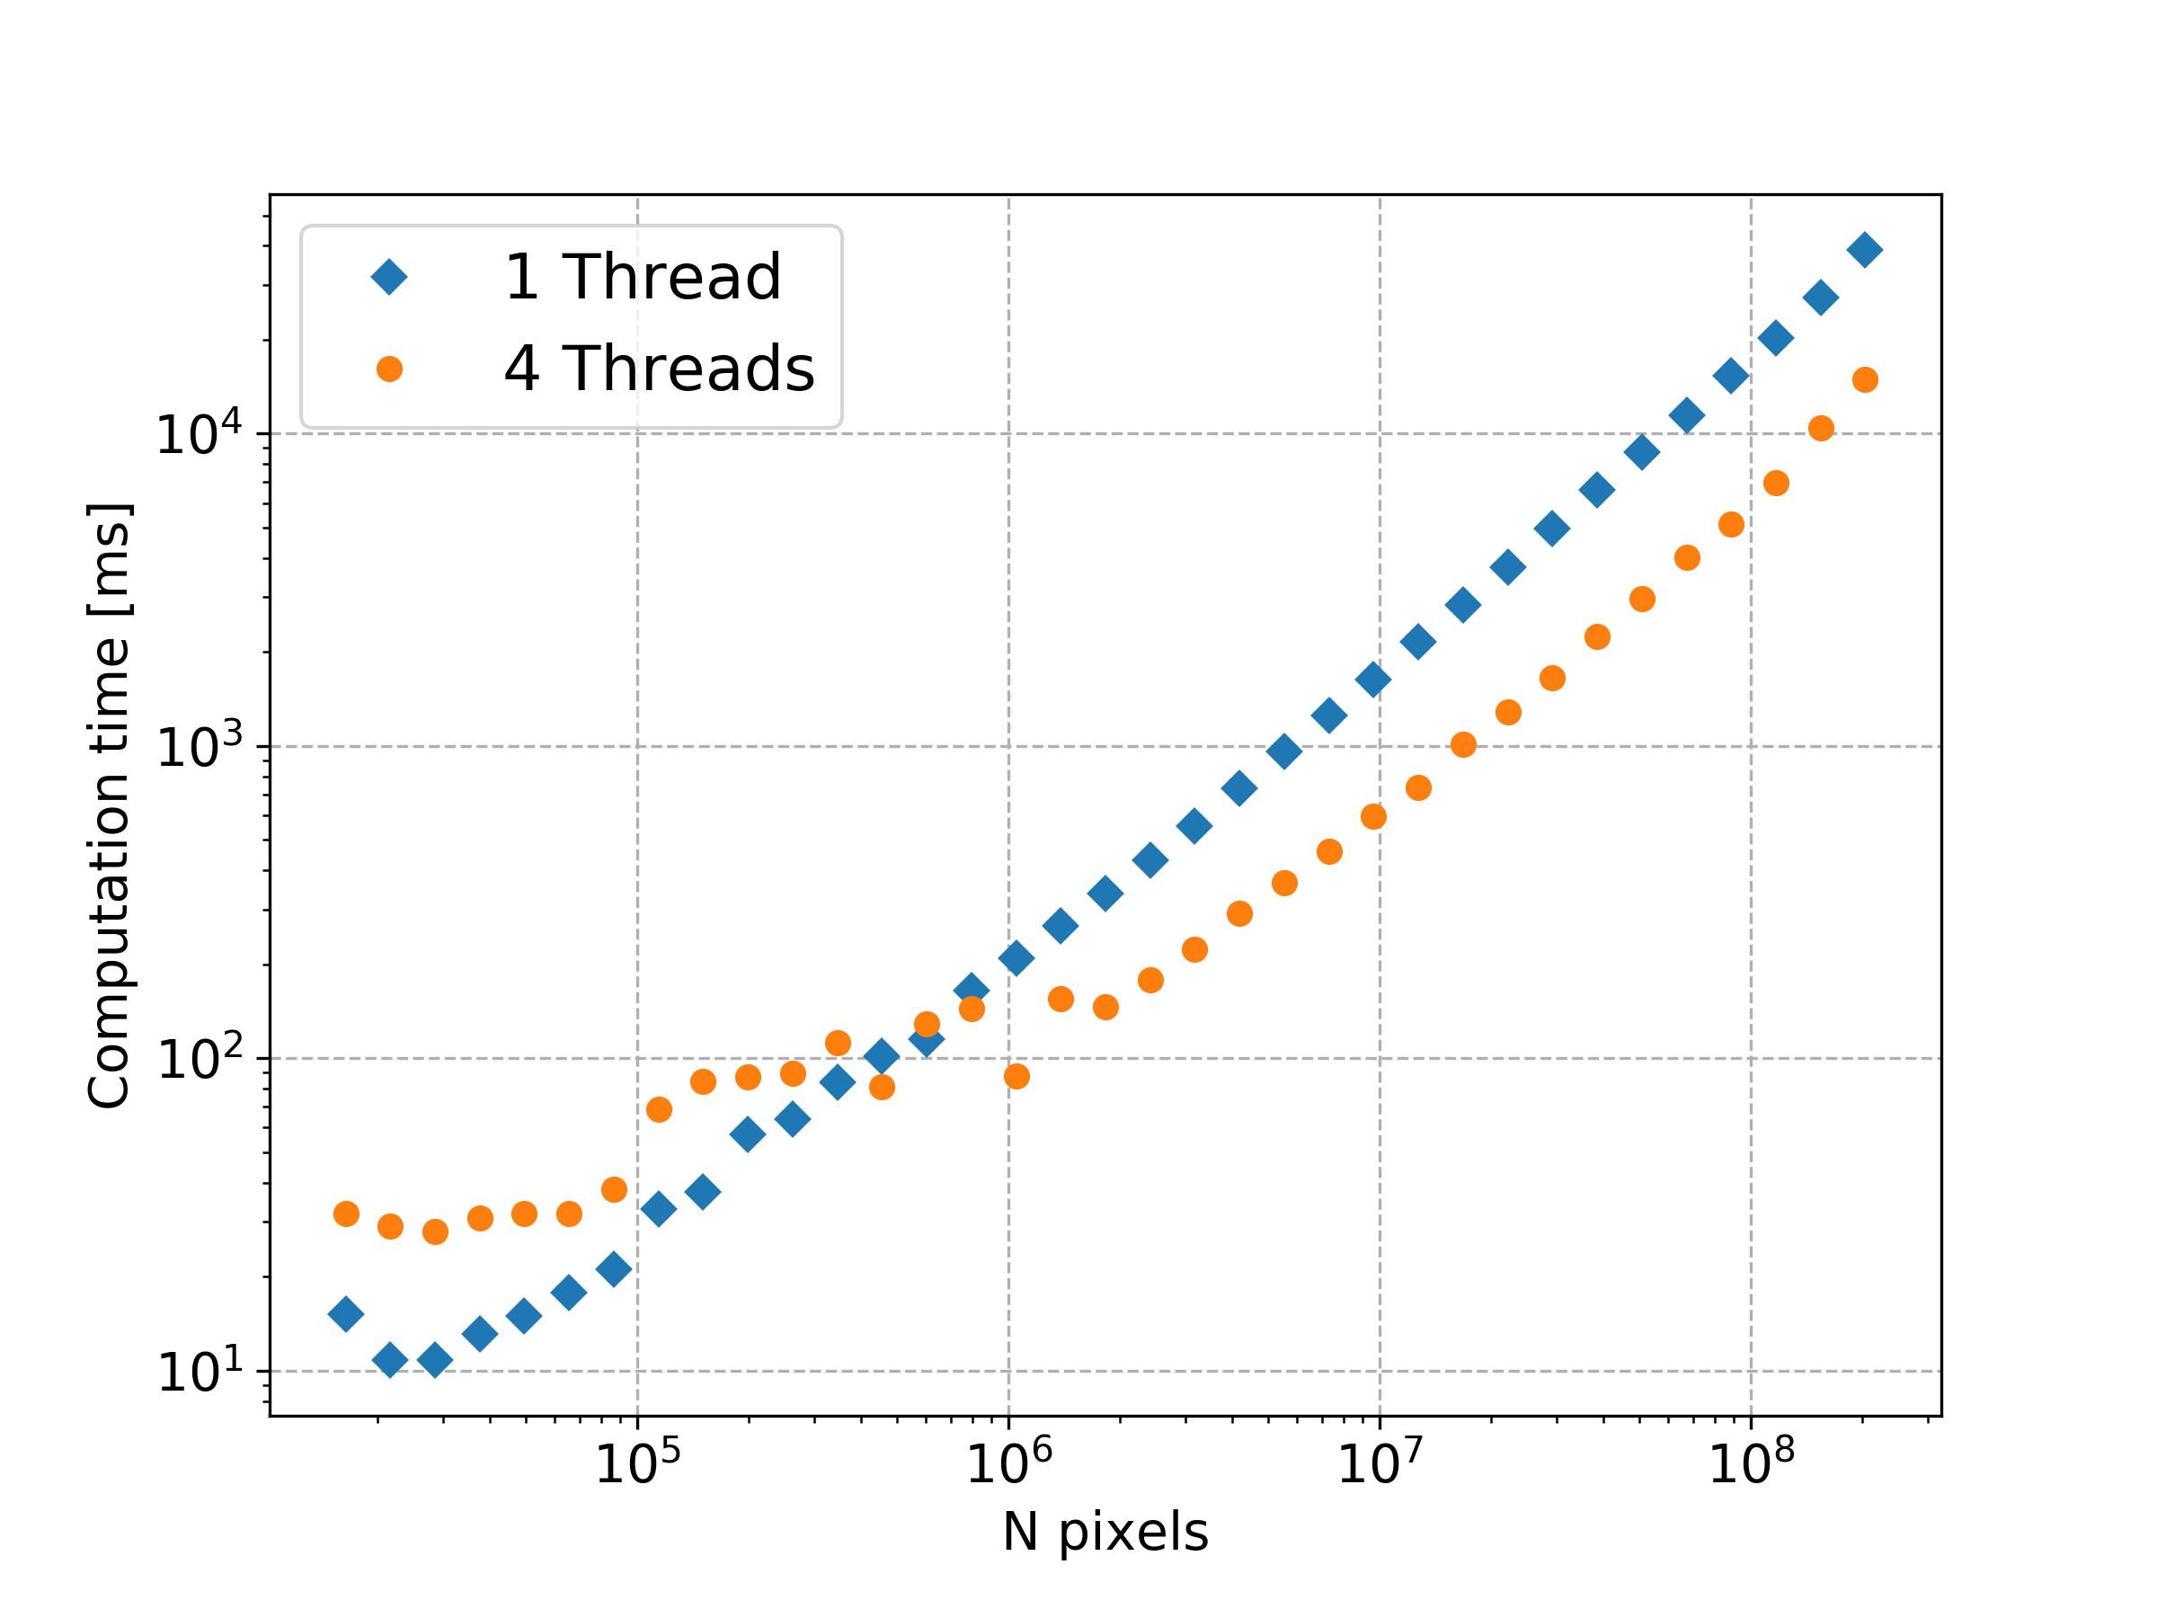
Performance scaling 1 vs. 4 threads
Linear scaling
Threading improves
Notes:
Not obvious enough
External IO
<number>

Slide 12

Current blocks
Raster manipulations:
File IO (through GDAL)
Combining
Math (+ - * / **)
Comparision (> < == != ~)
Logical (and, or, not, isdata, isnodata)
Spatial (smooth, dilate)
Temporal (resample, cumulative, shift)
Other (classify, reclassify, mask, clip)
Vector manipulations:
File IO (through GDAL)
Constructive (buffer, simplify)
Set operations (difference)
Operations vector properties
Rasterize
Raster aggregation (mean, sum, min, max, percentile)

Slide 13
Summary and Questions
dask-geomodeling: scalable GIS analytics in Python
Define a View
Generate a compute graph for a region
Compute it with dask
https://github.com/nens/dask-geomodeling
conda install -c conda-forge dask-geomodeling
Casper van der Wel - casper.vanderwel@nelen-schuurmans.nl
Nelen & Schuurmans Zakkendragershof 34-44, 3511 AE Utrecht www.nelen-schuurmans.nl

Slide 15
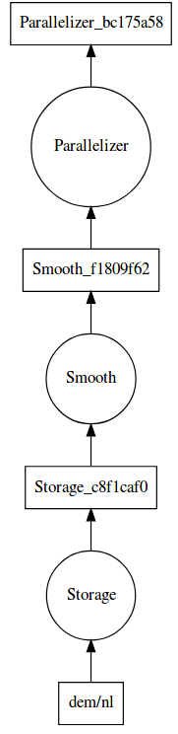
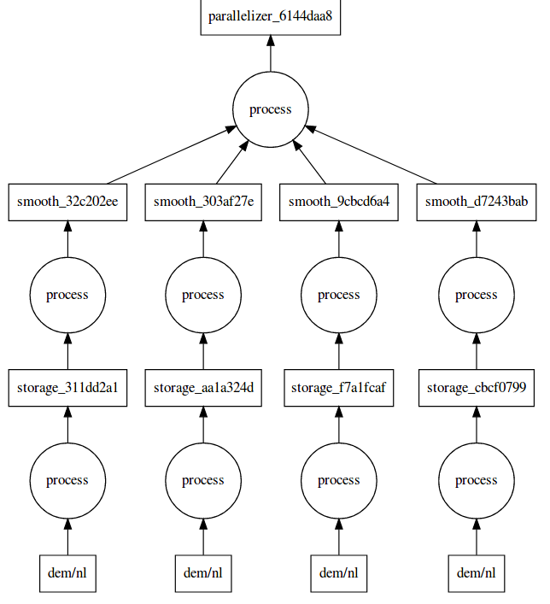
Parallel computation with dask-geomodeling
View
Compute

